Slide 1



20104079 Kalpesh Chavan
20104055 Nishant palav
20104083 Aaswit Kanhed
20104082 Ankit Awade
Project Guide
Prof. Roshna Sangle

Slide 2
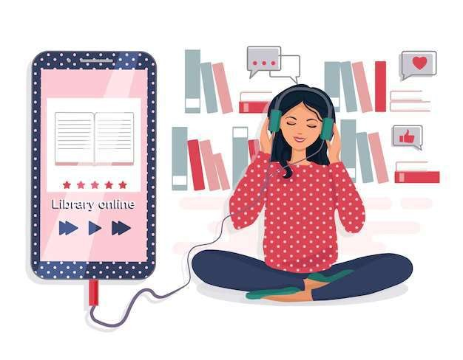

Topic : Audio Library for blind people
- Python Project (A)

Slide 3

Contents
Introduction
Objectives
Scope
Features / Functionality
Project Outcomes
Technology Stack
Block Diagram

Slide 4

1. Introduction
Problem Identified:
Scarcity of sources
Difficult to acquire educational material
Lack of educational institute for blind peoples
Limited options
Solution Proposed:
The convenience
Listen anytime (24/7)
Cost-effective
- Save your efforts
- Varity of content.

Slide 5

2. Objectives
To make a wonderful and invaluable tool for peoples who are blind or visually impaired
To make significant impact on their learning and skill development
To enrich their knowledge and providing information on different subjects through audio books
To build a user-friendly easily accessible application

Slide 6
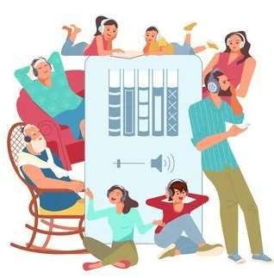
3. Scope
To provide same benefits as reading .
To develop self-learning skills .
To reduce user’s searching time and effort .
To provide a wide collection of audiobook ranges .
To provide user-friendly environment .
To upgrade users educational knowledge .
To build and enhance vital literacy skills .

Slide 7

4. Feature/Functionality
Help or Feedback Column
-If any buyer/customer has any issues regarding products quality, non- availability of wanted books, etc. can contact us on the help or feedback column.
Best Sellers and New Release Books
-Our customers can receive the latest information like best-selling books or newly released books of every category.

Slide 8

5. Outcome of Project
Users don't need to login or register(optional) .
Users can operate this application on any device .
User will be displayed with books available in the stock .
Users can listen any book any time .

Slide 9


6. Technology Stack
Web application built on

Slide 10

